Slide 1
AUDIO SYSTEM
April, 2020

Slide 2
AUDIO FRAMEWORK
Overview
Communication between CPU and ADSP
Communication inside CPU
Communication inside ADSP

Slide 3
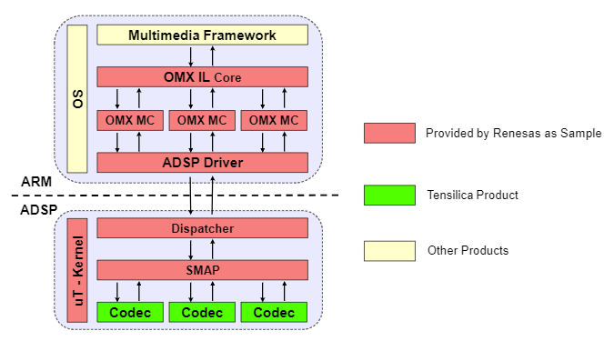
AUDIO FRAMEWORK
1. Overview

Slide 4
AUDIO FRAMEWORK
1. Overview
The audio framework includes following modules:
Multimedia Framework: The framework is provided by OS to support audio playback. For WEA7, DirectShow is the target multimedia framework.
OMX IL Core: OMX interface to communicate between multimedia framework and OMX MC.
OMX MC: OMX IL media component of each codec.
ADSP Driver: Driver to control ADSP module.
Dispatcher: Communicate with ADSP Driver to get the command from CPU side (ARM) and send the response from ADSP side (ADSP).
uT-kernel: Real time OS is used for small embedded system.
SMAP: The framework which utilizes the services provided by uT-Kernel to control the codec execution.
Codec: Tensilica audio codec libraries

Slide 5
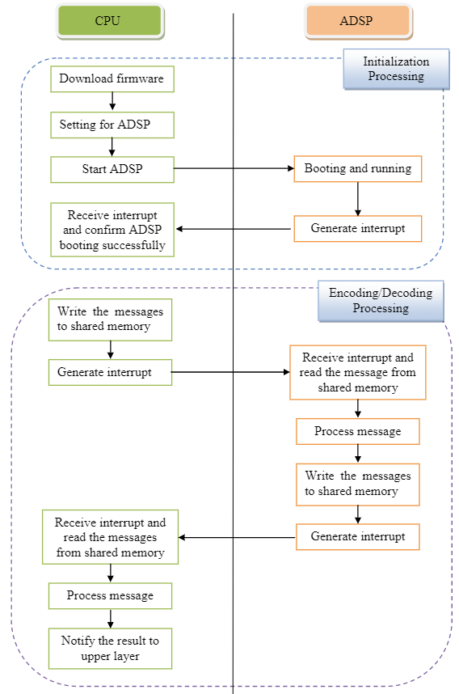
AUDIO FRAMEWORK
2. Communication between CPU and ADSP

Slide 6
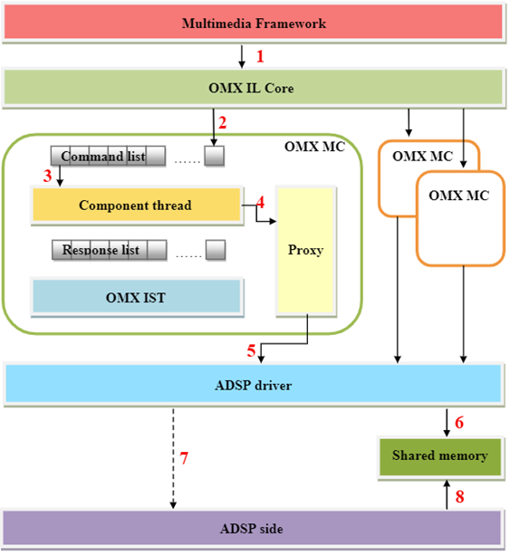
AUDIO FRAMEWORK
3. Communication inside CPU - Send data to ADSP
(1) - The multimedia framework submits the message
(2) - The messages are added to the tail of command list of an OMX MC
(3),(4) - If the command list is not empty, the Component thread reads the first element of command list (3) and sends it to Proxy (4)
(5),(6) - Proxy writes this message to the shared memory (6) through the functions ADSP driver (5)
(7),(8) - ADSP driver enables interrupt to ADSP side (7) to get data for encoding or decoding of ADSP side (8)

Slide 7
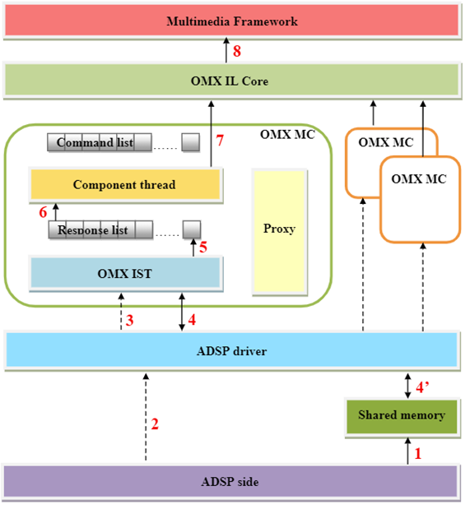
AUDIO FRAMEWORK
3. Communication inside CPU – Receive data from ADSP
(1), (2) When ADSP side finishes encoding or decoding a buffer, it writes message to shared memory (1) and enables interrupt to CPU side (2).
(3) When ADSP driver receives the interrupt from ADSP side, it wakes up all OMX IST of OMX MC
(4), (4’) When all OMX MC are waked up, they find the messages appreciated to themselves from shared memory through ADSP driver
(5) If they find comfortable messages, these messages are processed and added the tail of their response list
(6), (7), (8) If the response list is not empty, the Component thread reads the first element of response list (6) and sends it to multimedia framework through IL core (7), (8)

Slide 8
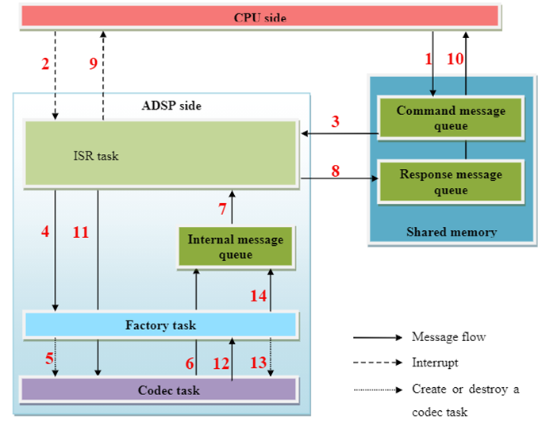
AUDIO FRAMEWORK
4. Communication inside ADSP
Initialize codec task: step (1) to (10)
Process the commands from CPU : step (1) to (11)
Destroy codec task: step (1) to (14)

Slide 9
AUDIO FRAMEWORK
4. Communication inside ADSP
(1), (2) CPU pushes a message to the command message queue (1) and raises an interrupt (2)
(3), (4) ISR task receives the interrupt and gets the message from command message queue (3), then sends it to factory task (4).
(5), (6) Factory task create codec task (5). After being created, codec task will push a response message to the internal message queue (6).
(7), (8), (9) ISR task gets the message from internal message queue (7), copies it to the response message queue (8) and raises an interrupt to CPU (9).
(10) CPU gets the message from response message queue
(11) ISR task send the message directly to the corresponding codec task
(12) The codec task sends the message to factory task
(13), (14) Factory task destroy the codec task (13) and push a response message to the internal message queue (14)

Slide 10
ADSP SYSTEM
Overview
ADSP Driver
ADSP framework
ADSP Plugins
Related HW module

Slide 11
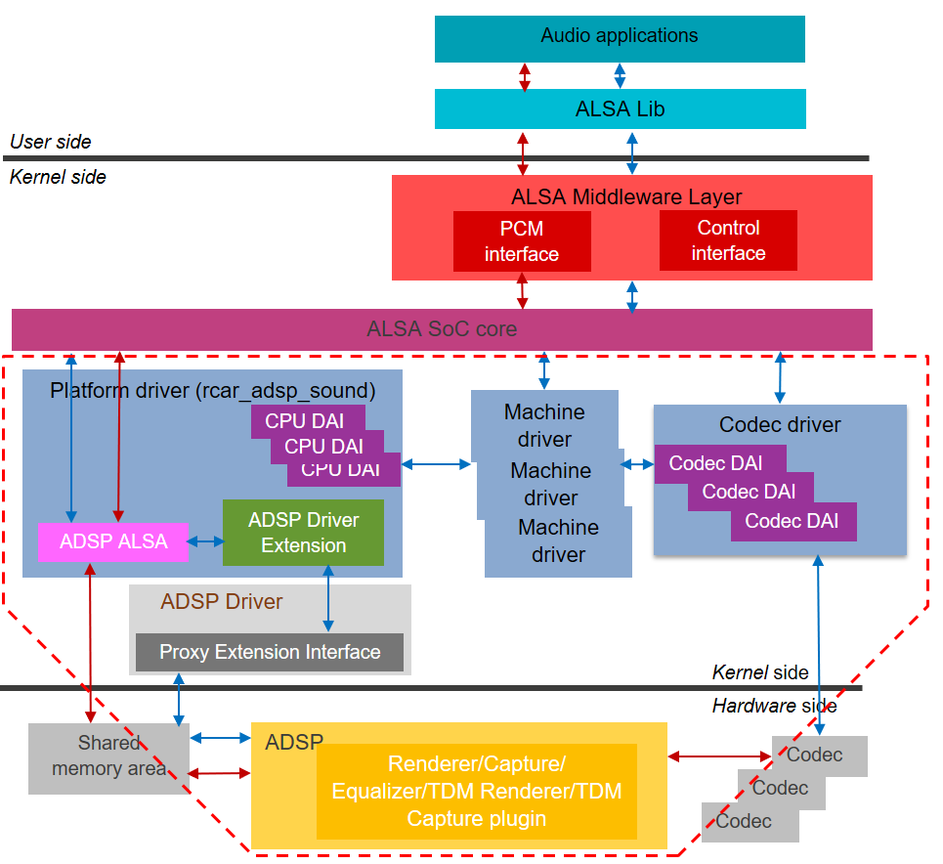
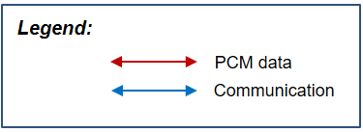
ADSP
1. Overview

Slide 12
ADSP SYSTEM
2. ADSP Driver
It includes 4 main parts:
ADSP ALSA: It is an ALSA device driver, implements to register a sound card for ADSP device. It provides callback functions for the native supports from ALSA framework to perform both playback and record
ADSP Driver Extension: It provides APIs for ADSP ALSA to connect to ADSP Driver (Proxy Extension Interface)
ADSP Driver (Proxy Extension Interface): APIs of methods through which ADSP Driver Extension communicates with shared memory area in Hardware side
CPU DAI: CPU DAI is the interface for the platform driver to communicate with other drivers

Slide 13
ADSP SYSTEM
2. ADSP Driver
List of usage:
Playback
Capture
TDM playback
TDM capture
Equalizer

Slide 14
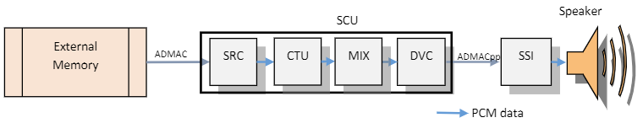
ADSP SYSTEM
2. ADSP Driver – Playback
Data path for playback
SCU : Sampling Rate Converter Unit
SRC : Sampling Rate Converter
CTU : Channel Transfer Unit
MIX : Mixer
DVC : Digital Volume and Mute Function
SSI : Serial Sound Interface

Slide 15
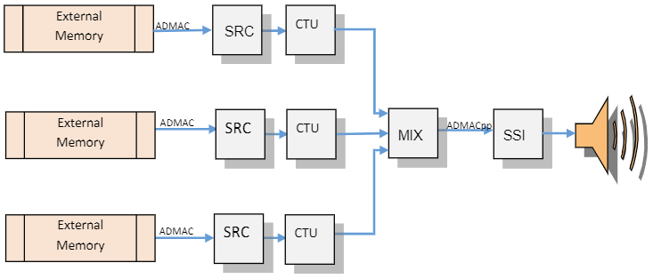
ADSP SYSTEM
2. ADSP Driver - Playback
Data path when mixing 3 streams
SRC : Sampling Rate Converter
CTU : Channel Transfer Unit
MIX : Mixer
SSI : Serial Sound Interface

Slide 16
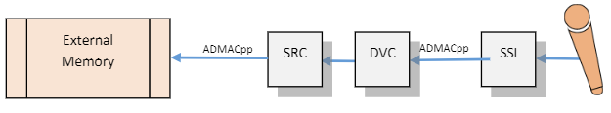
ADSP SYSTEM
2. ADSP Driver – Capture
Data path for capture
SRC : Sampling Rate Converter
DVC : Digital Volume and Mute Function
SSI : Serial Sound Interface

Slide 17
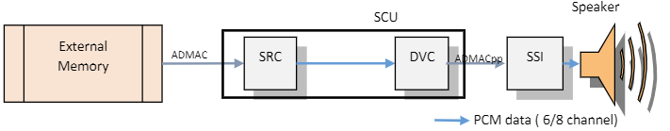
ADSP SYSTEM
2. ADSP Driver – TDM Playback
Data path for TDM playback
SCU : Sampling Rate Converter Unit
SRC : Sampling Rate Converter
DVC : Digital Volume and Mute Function
SSI : Serial Sound Interface

Slide 18
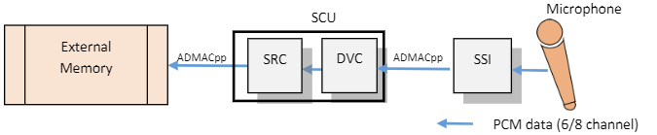
ADSP SYSTEM
2. ADSP Driver – TDM Capture
Data path for TDM playback
SCU : Sampling Rate Converter Unit
SRC : Sampling Rate Converter
DVC : Digital Volume and Mute Function
SSI : Serial Sound Interface

Slide 19
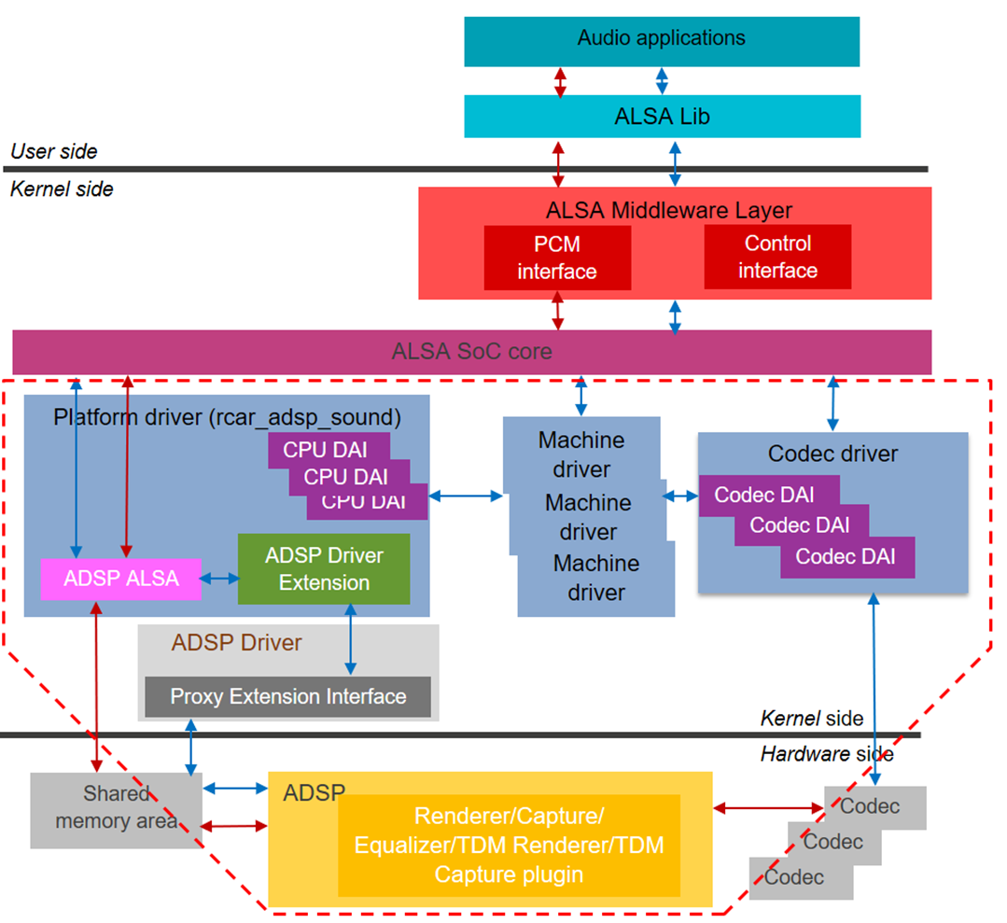
ADSP SYSTEM
3. ADSP Framework
ADSP Framework, ADSP Plugins,…

Slide 20
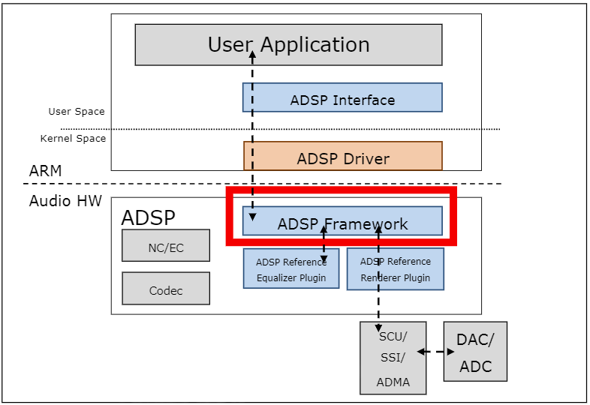
ADSP SYSTEM
4. ADSP Framework
Architecture of ADSP Framework

Slide 21
ADSP SYSTEM
4. ADSP Plugins
Renderer/Capture Plugin
Equalizer plugin
TDM Renderer/Capture plugin
ADSP
ADSP Framework
NC/EC
ADSP Plugins
Codec
ADSP in Hardware side

Slide 22
ADSP SYSTEM
5. Related HW module
SSI driver
SSIU driver
SCU driver
ADMAC driver
PDMA driver
FIFO driver

Slide 23
Thank you

